Slide 2
Global, five-year, $232M cooperative agreement
6 partners, led by the University of North Carolina at Chapel Hill (UNC)
Strategic objective Strengthen capacity in developing countries to gather, interpret, and use data to improve health

Slide 3
Local partners and capacity building are key
The prime is UNC and its partners are:
ICF
John Snow, Inc.
Management Sciences for Health
Palladium
Tulane University
MEASURE Evaluation works with more than 72 smaller subawardees in more than 40 countries
Over 26 percent of project funding goes back to minor subawardees

Slide 4
Global footprint (more than 40 countries)

Slide 5
Measuring
what counts
Strengthening health information systems contributes to epidemic control

Slide 6
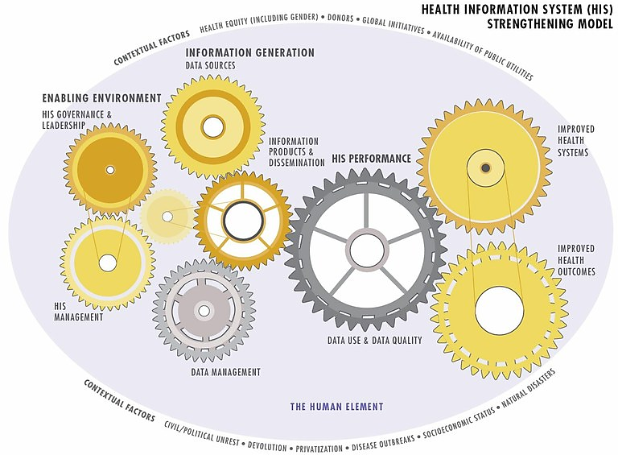
Health Information System Strengthening Model
(HISSM)
Notes:
Describe HISSM, it’s purpose and uses, including to give a common framework and language to HIS and means to approach HIS strengthening, breaking it into digestible pieces to achieve HIS performance.
Model being used now in a number of contexts and countries for assessments and planning purposes.

Slide 7
What is a health information system?
A strong health information system (HIS) captures health system information needs.
An HIS covers all health system functions.
The data elements collected represent the full range of health services and programs available in a country, including HIV and other disease-specific programs.
A strong HIS contains comprehensive data sources, including laboratory, population, logistics, and workforce information.
A strong HIS is integrated and interoperable.
Digital HIS applies technology to the HIS.
Notes:
Briefly describe what is meant when we say HIS

Slide 8
How does a strong HIS contribute to epidemic control?
Provides reliable data sources to track progress and plan for epidemic control efforts
Facilitates data exchange to identify health priorities and gaps for epidemic control
Reduces duplicative efforts in data collection and reporting
Creates opportunities for improved data analysis and engagement with data
Expands the programmatic questions that can be answered about the nature of the epidemic and epidemic control efforts
Notes:
Briefly describe what is meant when we say HIS

Slide 9
Related terms
Routine health information system(s) (RHIS):
Facility-based HIS that collect routine health information. These systems generate data collected at public and private health facilities and institutions, and at community-level healthcare posts and clinics.
Health management information system(s) (HMIS):
Often used interchangeably with RHIS, though an HMIS may not include data on disease or health outcomes. An HMIS is a data collection system designed to support planning, management, and decision making in health facilities and organizations.
Community-based health information system(s) (CHIS or CBIS):
Data collected from a community (not clinical) health setting. Communities may be linked to a facility or a district.
Notes:
And expand to how we think about other common HIS terms

Slide 10
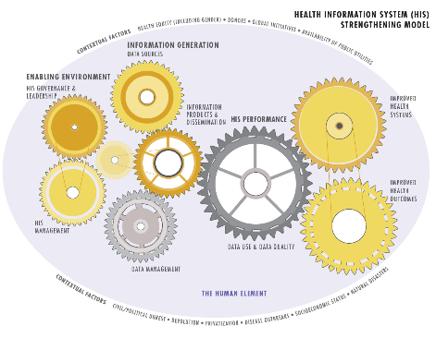
HIS strengthening for health system improvement
HEALTH SYSTEM
Leadership/ governance
Healthcare financing
Health workforce
Medical products, technologies
Information and research
Service delivery
A strong HIS
What is a strong HIS?
Intervention resources for HIS strengthening
Data demand and use
Digital health
Assessment tools for specific HIS and health areas
Notes:
This slide illustrates WHO Health System Building blocks i.e. Leadership and governance, health financing, health workforce, medical products and technologies, information and service delivery and how HIS contributes to the health system improvement. As you can see a Strong HIS is key to all the building blocks. The HIS stages tool explains how to progress toward a strong HIS, monitor and measure the progress. This tool helps identify gaps and appropriate interventions to overcome those gaps. It also help determine which other tools are useful. For example, assessment might highlight data use or interoperability or routine system performance management as key issues for which you can use appropriate tools.

Slide 11
Resources for HIS strengthening
https://www.measureevaluation.org/his-strengthening-resource-center
Notes:
Mention the resource center and searchable HIS tool database. You can find a tool for your purposes.

Slide 12
Strengthening HIS
Highlights from Uganda
Uganda is committed to applying and using globally developed and recommended assessment tools.
The health ministry implemented MEASURE Evaluation’s HIS Stages of Continuous Improvement (SOCI) Toolkit to describe the current stage of HIS and to identify gaps and challenges within the HIS to design a roadmap of the way forward.
The ministry also implemented our HIS Interoperability Maturity Toolkit to assess readiness for interoperable systems.

Slide 13
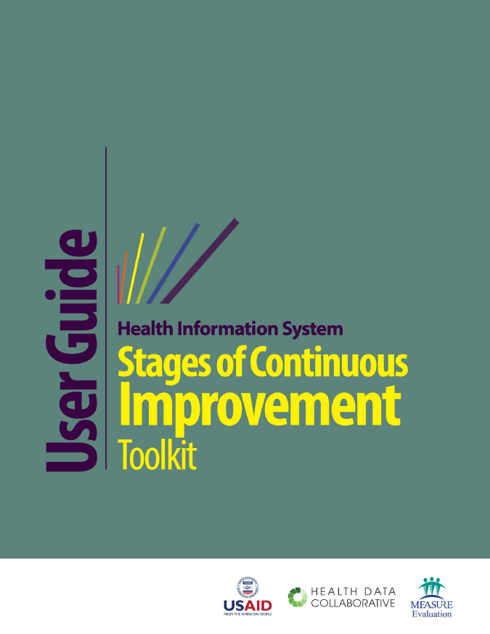
HIS stages of continuous improvement
(SOCI)
https://www.measureevaluation.org/his-strengthening-resource-center/his-stages-of-continuous-improvement-toolkit/
Notes:
The toolkit is available on the MEASURE website and includes a user guide, measurement scale and the excel based tool.

Slide 14
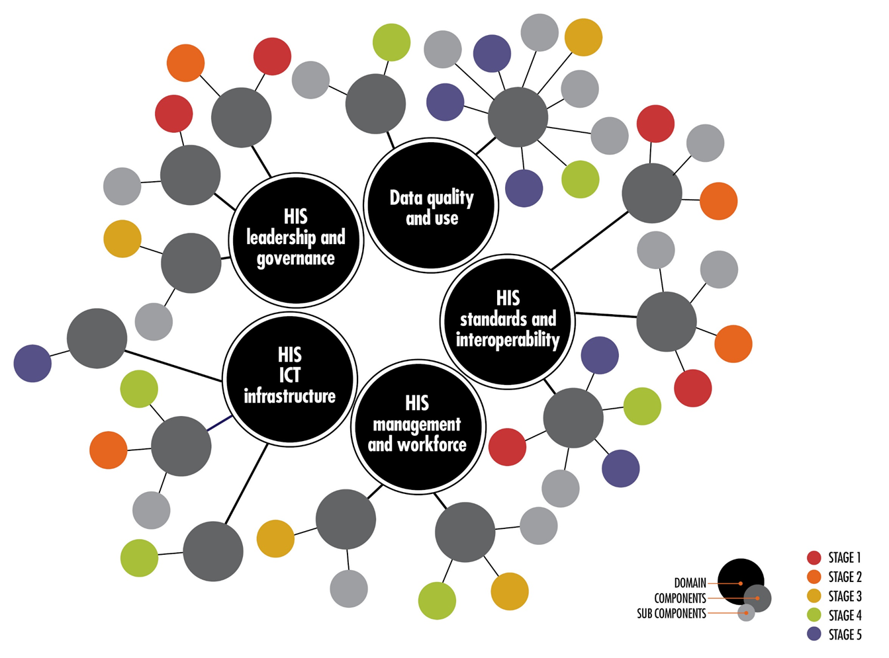
HIS stages of continuous improvement
(SOCI)
Notes:
One of the challenges in HIS strengthening has been to address the need to understand status and determine the goal for developing improvement roadmap and related HIS interventions. Building on the HIS Strengthening model mentioned earlier in this presentation, and also leveraging the WHO-ITU ehealth strategy and other maturity model efforts in health and non-health sectors we came up with a comprehensive approach to addressing essential components and subcomponents of an HIS. The demand came from the country stakeholders and we collaborated with the CDC team and the HDC team in this effort.
This graphic shows the five domains and how components and sub-components are associated with each of the domains. The colors show stages of each sub-component which is often non-linear and is interconnected with one another.

Slide 15
HIS SOCI
Roadmap of the way forward
Strengthen data exchange, in alignment with the interoperability assessment findings
Develop a master facility registry to improve data management
Trainings to build HIS competencies of health workforce
Plan to create an HIS strategic plan to enhance HIS leadership and coordination
Action items to improve data use for decision making

Slide 16
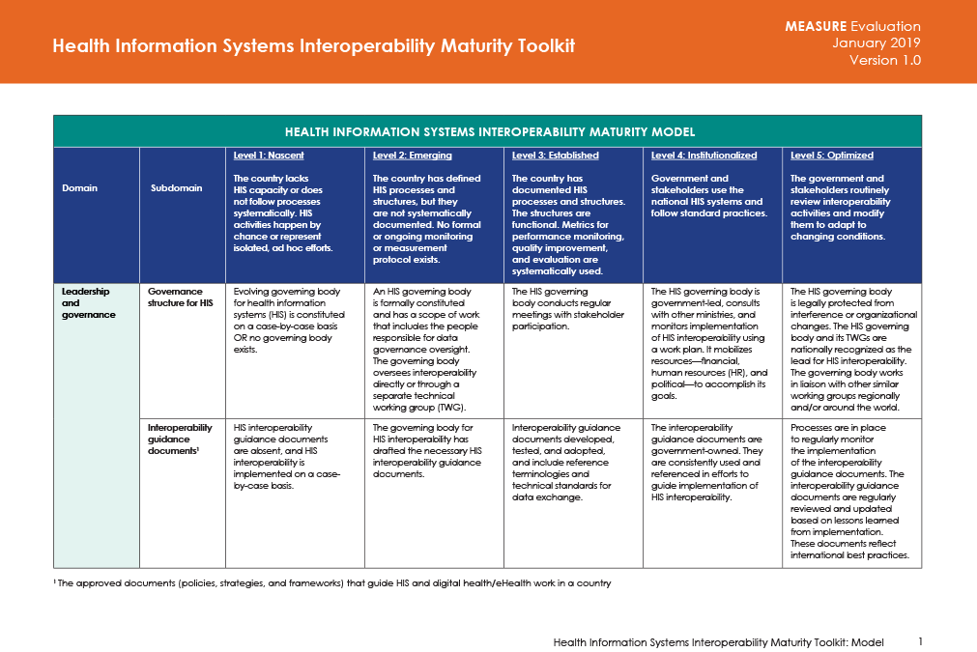
HIS Interoperability Maturity Toolkit
Notes:
The interoperability toolkit was published in December 2017 and is available on MEASURE Evaluation and HDC websites

Slide 17
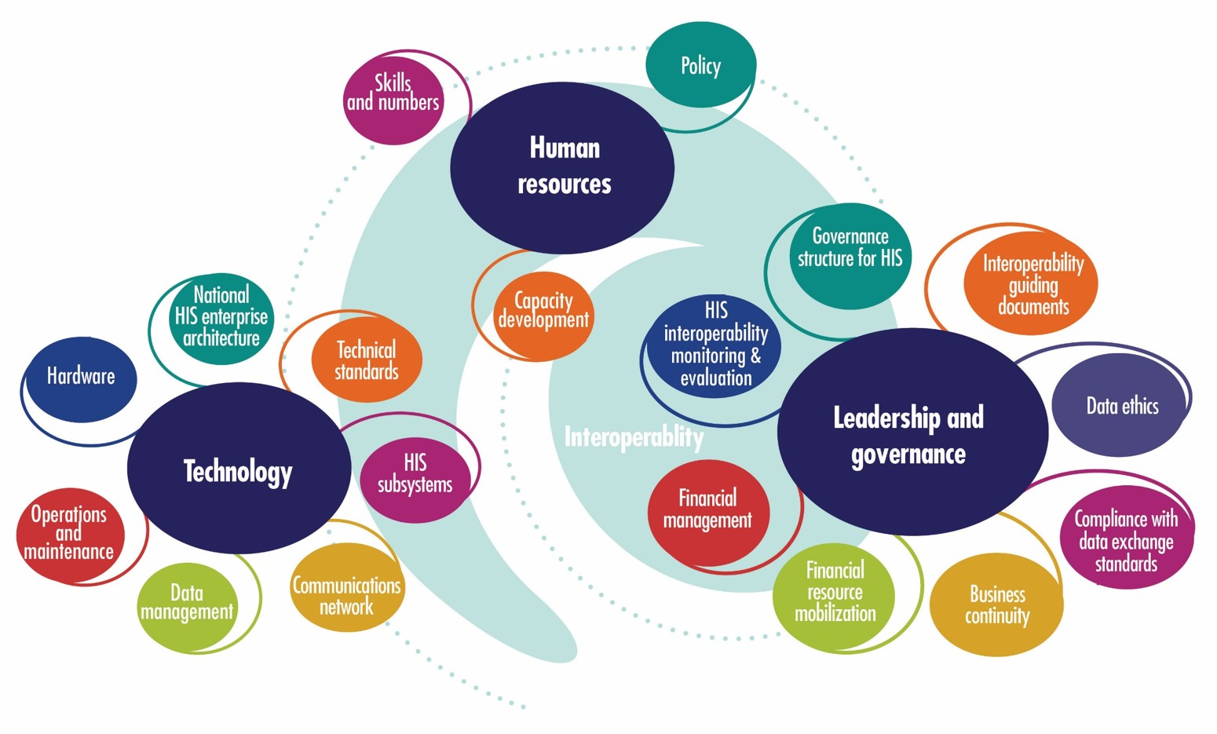
Digital health and interoperability
Notes:
As I mentioned earlier, the DATIM4U team of MEASURE contributed to the HIS interoperability toolkit and the toolkit was informed by the HIS Strengthening model and other similar frameworks. It has three domains that is leadership and governance, human resources and technology and related sub-domains.

Slide 18
HIS interoperability assessment
Roadmap of the way forward
Produce a country digital health profile
Inform Uganda privacy and security guidelines
Plan long-term capacity building for staff at all levels of the health system
Strengthen data exchange
Notes:
This toolkit was also developed in collaboration with HDC. Many countries have completed assessments and more in progress in east Africa. The assessment has informed digital profile of country. Uganda drafted its privacy guidelines based on the findings of the assessment. Also, published a comparative document describing HIS Stages, HIS Interoperability, Digital Health Investment Review Tool, Global Digital Health Index, Digital Health Atlas and the Global Goods Maturity Model.

Slide 19
Resources
HIS Strengthening Resource Center
https://www.measureevaluation.org/his-strengthening-resource-center

Slide 20
Measuring
what counts
Strengthening routine health information systems contributes to epidemic control

Slide 21
Strengthening RHIS for HIV
Review definition of RHIS and provide description of what types of RHIS data are collected for HIV
Provide short country examples for how PEPFAR countries have benefitted from PEPFAR investments in national RHIS systems
Discuss an in-depth example of how Côte D’Ivoire has used strengthened RHIS to advance HIV program outcomes

Slide 22
Related terms
Routine health information system(s) (RHIS):
Facility-based HIS that collect routine health information. These systems generate data collected at public and private health facilities and institutions, and at community-level healthcare posts and clinics.
Health management information system(s) (HMIS):
Often used interchangeably with RHIS, though an HMIS may not include data on disease or health outcomes. An HMIS is a data collection system designed to support planning, management, and decision making in health facilities and organizations.
Community-based health information system(s) (CHIS or CBIS):
Data collected from a community (not clinical) health setting. Communities may be linked to a facility or a district.
Notes:
And expand to how we think about other common HIS terms

Slide 23
Our work in Burundi
With support from USAID and PEPFAR and in partnership with the Burundi health ministry, MEASURE Evaluation—guided by a 2013 Performance of Routine Information System Management (PRISM) assessment—contributed the following:
Supported integration of HIV, malaria, and community-based information in DHIS 2 to improve data quality
Strengthened capacity to collect, analyze, and disseminate data on testing yields to identify the highest-yield entry points
Developed and disseminated surveillance sentinel protocol with associated data collection and supervision tools
https://www.measureevaluation.org/resources/publications/fs-17-249
Notes:
Adult HIV Prevalence 1.1% (2017)
Problem: multiple siloed data collection systems for routine data, HIV/AIDS data, and community-based data
PRISM Assessment 2013 guided interventions
Key interventions:
Developed and integrated an HIV/AIDS database into GESIS platform and then migrated that into an HIV module in DHIS 2;
improving facility-based information systems; building a harmonized community-based information system, and improving the M&E system for the NACP;
PRISM monitoring tools also integrated as a component of supervisory tools for checking data quality and use of information

Slide 24
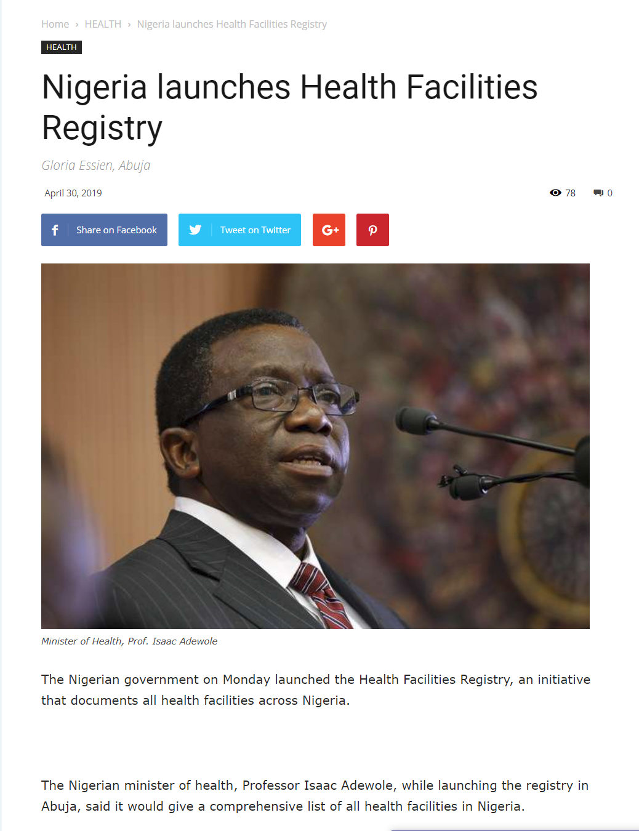
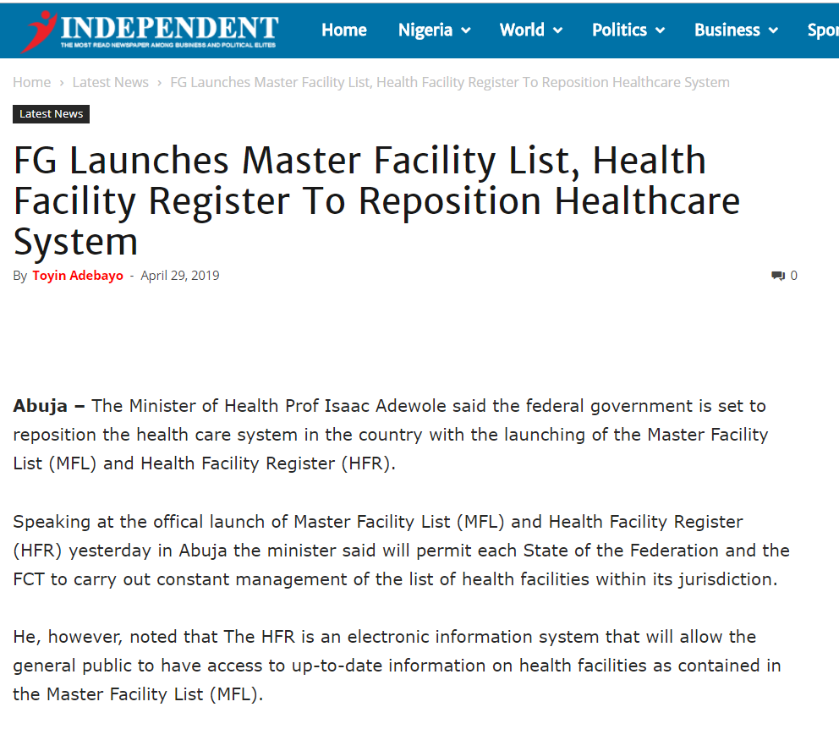
Our work in Nigeria
With MEASURE Evaluation’s support:
Facility lists from 37 states integrated in master and validated: approximately 40,000 facilities
National Health Facility Registry developed, hosted, and deployed with ability to exchange data
Nigeria OVC* Management Information System established
OVC: Orphans and vulnerable children
https://www.measureevaluation.org/resources/publications/tr-18-267
Notes:
Problems: Multiple facility lists; Outdated census (2006), incomplete data on HFR, and multiple vertical disease-based records; poor coordination and integration of health programs; lack of policies
Outcome: Fully documented system, SOPs, capacitated staff at national and state level, MOH ownership

Slide 25
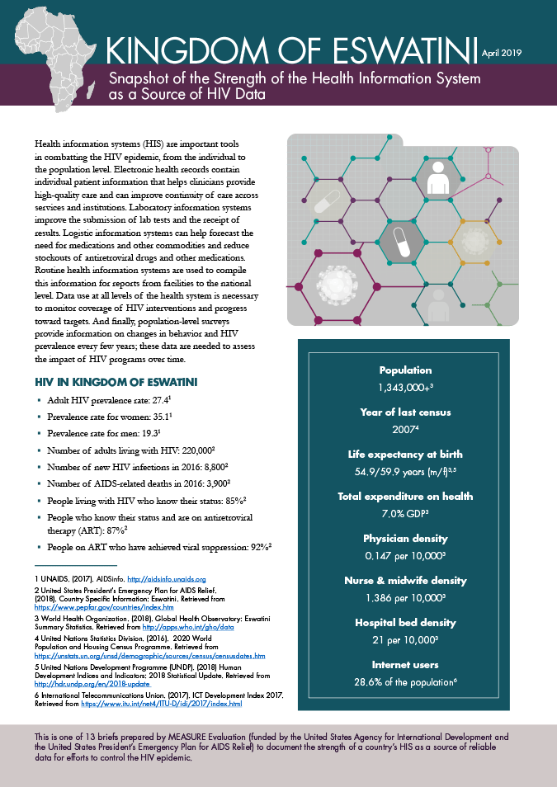
Our work in Eswatini
Mentored Ministry of Health’s Strategic Information Department Monitoring and Evaluation Unit (SID/M&E) to improve architectural and infrastructural framework of the client management information system: an electronic health record (EHR) system
EHRs improved patient care, patient flow and wait times, and data quality and access
https://www.measureevaluation.org/resources/publications/fs-17-244
Notes:
Problem: Parallel health information systems (HIS) for HIV/AIDS, tuberculosis, noncommunicable diseases, sexual and reproductive health, and child health
Outcome: improved MOH efficiency to manage patients and their data through an electronic health record by building capacity of local implementer who was MOH strategic partner (Institute of Health Measurement) to design enterprise architecture, develop CMIS, and deploy across the country

Slide 26
Measuring
what counts
Strengthening RHIS to reach 90-90-90 goals in Côte d’Ivoire

Slide 27
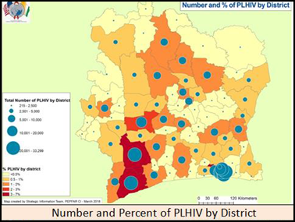
HIV in Côte d’Ivoire*
* Map from the United States President’s Emergency Plan for AIDS Relief (PEPFAR) Côte d’Ivoire 2018 Country Operational Plan (COP) Strategic Direction Summary

Slide 28
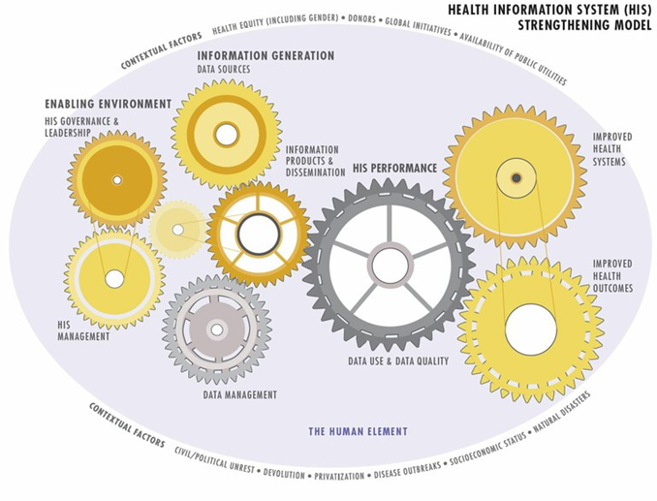
What: Results of investments
in the HIS
Notes:
This study was implemented in the context of MEASURE Evaluation’s Health Information System Strengthening Model, looking at how these areas work together to lead to improved health systems and ultimately improved health outcomes.

Slide 29
What: Results of investments
in the HIS
Objectives
Learn how investments to strengthen RHIS affect HIS performance, health system outcomes, and public health outcomes.
Explore barriers and incentives to using government tools and data systems to improve information systems, analyses, and syntheses and health programs and outcomes.
Understand how interventions intended to improve the performance of HIV information systems contributed to achievement of the global 90-90-90 goals.
This activity consisted of:
A document review
A qualitative study

Slide 30
Where: Qualitative study design
Region | District
Abidjan 2 | Abobo Ouest
 | Port Bouet
Gboklé Nawa San Pedro | San Pedro
 | Soubré
Gbêké | Bouaké Sud
 | Bouaké Nord Est
Notes:
Researchers implemented in-depth interviews with key informants across several stakeholder categories in six health districts in three regions of Côte d’Ivoire.

Slide 31
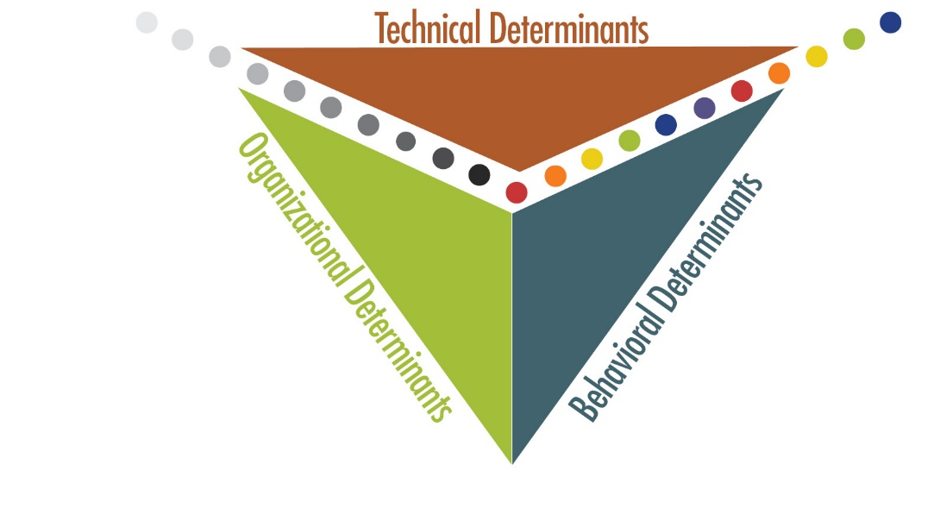
Major HIS strengthening interventions
Performance of Routine Information System Management (PRISM) assessments
Development and implementation of data quality assessment (DQA) and routine data quality assessment (RDQA) tools
Standardization of indicators and tools
Implementation of electronic systems, such as DHIS 2 (used for aggregate patient and facility HIV data) and the Management Tool for Electronic Patient Files (referred to as SIGDEP, Versions 1 and 2)

Slide 32
Findings
How are the major HIS strengthening interventions implemented over the past 10 years associated with HIS performance (defined as data quality and use)?
Improvements in data quality
Improvements in data use

Slide 33
Findings
Improvements in data quality
Development of standard tools: Seen as a great achievement by many respondents
Data quality: Timeliness has improved
Supervision process was improved by the implementation of tools such as DHIS 2:
…once the supervision teams arrive, the information already extracted at the central level can be compared with the information at the supervised level without any gap. (Government respondent)

Slide 34
Findings
Improvements in data quality:
Interaction with implementing partners
Implementing partners often have additional resources that they can commit to the sites in which they work.
The fact that we have human resources dedicated to data management activities makes it possible to have better results, because the data monitor assistant (AMD) at the site assists providers in the use of data collection tools, and accompanies them in the preparation of the counseling and testing report and the prevention of mother-to-child transmission (PMTCT) report, as the data are available. (Nongovernment respondent)
Notes:
For those of you that may not be familiar with PEPFAR, the circuit of funding goes from the program to U.S. Government agencies to partner organizations in the field known as “implementing partners.”
When asked about improvements in data quality, one respondent stated that they had observed great improvements in PEPFAR-specific data. One reason for this could be that IPs also have additional resources that they can commit to the sites in which they work, such as supporting salaries for data monitoring assistants or data clerks. The role and its benefit are described by a non-government respondent.
Sites that have data clerks will be able to pay closer attention to the quality of the data that is being collected, transmitted, and used—but the data clerks are not in every site: one respondent said that the decision to place a data clerk at a site depends on the number of patients and the availability of resources.

Slide 35
Findings
Improvements in data quality
DHIS 2 has been instrumental in improving data quality through internal validation and by making the data available faster. For example, one respondent discussed how using DHIS 2 made data immediately available and ended the need to travel to collect data from facilities:
SIGDEP2 was also credited with increasing access to data.
With SIG-VISION, we have to return to the base, return to [the] hospital, which is 85 km away, to do the [data] entry. Now with DHIS 2, we have the data without going out. And when we enter the data here…the regional manager can already access our data, which was not the case with SIG. (Government respondent)

Slide 36
Findings
Improvements in data use
With DHIS 2:
Easier to review and provide feedback so corrections can be made
Reporting is easier
Data are more accessible
¹ Department of Informatics and Health Information
² National AIDS Control Program
I think one of the examples for me that is edifying is the national HIV report that the Ministry of Health through DIIS¹ and the PNLS² is developing. This information, in the past, I would say was not an easy thing to have. Today, with standardized data collection tools and a clear dictionary of indicators that allow us to know what is needed with SIGDEP and DHIS 2, information is available from lower levels to the central level. This makes it possible to compile the data and prepare an annual report by region, by district without great difficulty. (Nongovernment respondent)

Slide 37
Findings
Improvements in data use
Importance of monitoring and evaluation (M&E) trainings:
After the training, we saw the importance of providing quality data, which would help us make good decisions. In other words, it is the collective awareness of the trained staff about the importance of providing quality data that made this activity a success. (Nongovernment respondent)

Slide 38
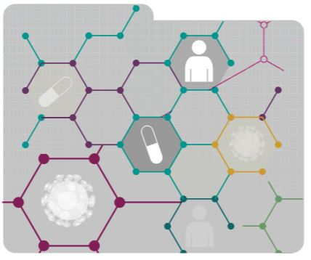
Findings
What were the health system outcomes associated with the HIS interventions—specifically HIV program course corrections contributing to controlling the epidemic (90-90-90)?
DHIS 2 data availability and timeliness allow identification of areas not meeting HIV testing targets.
SIGDEP2 allows for continuity of care for patients in treatment.
An electronic system makes it easier for providers to identify who has missed an appointment and reach out to them.
Notes:
The health information system is only as strong as the health system.
HIS is important, but if it is not supported by a well-functioning health system its strength is irrelevant (e.g., viral load access—you can document viral load, but if laboratory capacity is not adequate, then the HIS will not help).

Slide 39
Recommendations (1)
Continue to fund interoperability efforts if they are not yet complete, specifically between SIGDEP2 and DHIS 2.
Continue to fund or increase funding for supportive supervision down to the facility level.
Adopt and fund an official data manager (or similar) position within the government health structure.
Explore ways to broaden inclusion of the private sector in HIV elimination efforts.
Notes:
Funding interoperability between SIGDEP2 and DHIS 2 will improve the quality and availability of routine data, contributing to the existing cache of information on which health outcome evaluations can be based.
The “last mile” is a concept developed in pharmaceutical distribution, but it can apply to other areas of need as well. The “last mile” of training and coaching on data quality is to the facility and community, as health care staff at these levels are producing the data upon which programming decisions and evaluations are based. This is not a currently “sexy” idea, to put more resources toward supportive supervision, but funding for the logistics of this task can have a substantial influence on the availability of reliable valid data.
Codifying data management as a requisite task within the health system can relieve pressure on clinicians while ensuring essential data-related tasks are completed. Inclusion of an official position would provide leverage to lobby for funding and work toward sustainability of this key function in a future circumstance that we can imagine in which donor funding is not supporting this function. We can also envision eventual universal saturation of data management within the health system if such a position were to be made official, compared to piecemeal coverage dependent on implementing partner and donor priorities.
The private sector makes up as much as 50% of clinics and health care providers in Cote d’Ivoire. If we are truly interested in controlling the epidemic, efforts to inculcate these facilities with a culture of data use and to bring their HIV data into the national health information system would only contribute to this objective.

Slide 40
Recommendations (2)
Encourage discussions across stakeholders to streamline data collection efforts, reduce the need for supplemental data collection platforms among implementing partners, and identify means for the government to adequately share data regularly and in a timely manner with stakeholders such as community and private-sector partners that may not contribute data to the national DHIS 2 database.
Consider the benefits of funding in-depth M&E training for people in positions of leadership.
Visualize saturation as the goal of developing a culture of data use.
Notes:
Encourage discussions across stakeholders to further streamline data collection efforts, reduce the need for supplemental data collection platforms among implementing partners, and identify means for the government to adequately share data regularly and in a timely manner with stakeholders such as community and private sector partners that may not contribute data to the national DHIS 2 database.
Consider the benefits of funding in-depth M&E training for people in positions of leadership. Even if they do not remain in a current position, many personnel that have been trained in the past are still operating in the field of HIV. Contributing to a cadre of health administrators and policymakers that have this background can only benefit efforts to end the epidemic.
Visualize saturation as the goal of developing a culture of data use. The people producing the data at the facility level must understand the connection between data collection, program shifts intended to improve performance, and improved health outcomes in their local population and beyond.

Slide 41
More information
Understanding the Influence of Health Information Systems Investments on Health Outcomes in Côte d’Ivoire: A Qualitative Study
https://www.measureevaluation.org/resources/publications/tr-19-332
Strengthening Côte d’Ivoire's Health Information System to Combat HIV: Validating Data on the Effectiveness of Interventions
https://www.measureevaluation.org/resources/publications/tr-18-291

Slide 42
Acknowledgments
Study respondents
Côte d’Ivoire Ministry of Health and Public Hygiene:
Strategic Information and Informatics Department (MSHP–DIIS)
National AIDS Control Program (MSHP–PNLS)
MEASURE Evaluation in Côte d’Ivoire
USAID and PEPFAR
Notes:
This evaluation has been a success due to enthusiastic collaboration with the MSHP’s Department of Informatics and Strategic Information, who accompanied us to most interviews, including outside of Abidjan. We would not have been able to gather this rich data without the support of MEASURE Evaluation’s in-country office and the participation of respondents in Abidjan, San Pedro, Soubré, and Bouaké.

Slide 43
Measuring
what counts
Strengthening health management information systems contributes to epidemic control

Slide 44
The HMIS: Triangulating data at the project level
Review definition of the HMIS and discuss data triangulation
Provide short examples of how programs have used existing HMIS resources to check for gender gaps in index testing data and to create detailed service cascades for key populations
Discuss an in-depth example of how programs for orphans and vulnerable children (OVC) have used routine monitoring, evaluation, and reporting (MER) data with their own project HMIS data to improve coverage of HIV testing among OVC

Slide 45
Related terms
Routine health information system(s) (RHIS):
Facility-based HIS that collect routine health information. These systems generate data collected at public and private health facilities and institutions, and at community-level healthcare posts and clinics.
Health management information system(s) (HMIS):
Often used interchangeably with RHIS, though an HMIS may not include data on disease or health outcomes. An HMIS is a data collection system designed to support planning, management, and decision making in health facilities and organizations.
Community-based health information system(s) (CHIS or CBIS):
Data collected from a community (not clinical) health setting. Communities may be linked to a facility or a district.
Notes:
And expand to how we think about other common HIS terms

Slide 46
HMIS data sources
Routinely reported site-level data (e.g., from national RHIS; CBIS; PEPFAR’s Data for Accountability, Transparency and Impact [DATIM] system; the Global Fund to Fight AIDS, Tuberculosis and Malaria)
Project HMIS driven by project logic model or theory of change
www.measureevaluation.org/community-based-indicators

Slide 47
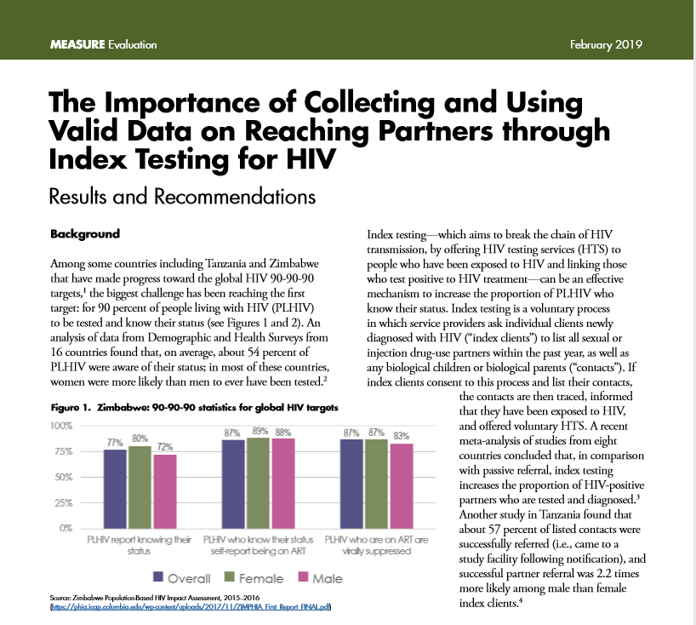
Index testing in Zimbabwe and Tanzania
Concern that index testing may not generate target referral testing yields because of:
Overrepresentation of women accessing HIV services and therefore as index clients
History of underreporting of partners and risky behaviors by women in sexual and behavior surveys
To address this, our study of index testing in Zimbabwe and Tanzania used project HMIS data from selected USAID- and PEPFAR-supported programs in the first two quarters of 2018. We found:
In Zimbabwe and Tanzania, females were more likely than males to be index clients.
Females were as likely in Tanzania or slightly less likely in Zimbabwe to refer partners who later tested positive.
Geography and age were also important predictors of HIV testing services yield from index quality.
www.measureevaluation.org/resources/publications/fs-19-333

Slide 48
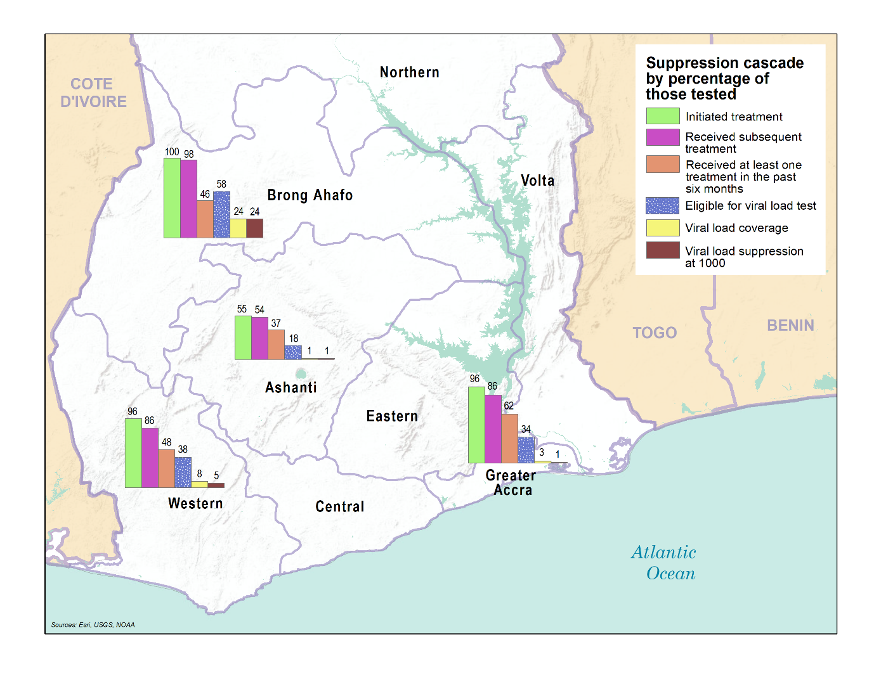
“Enhanced” HIV treatment cascades among key populations
Notes:
Grand challenge
Adherence.
Data from 4GH-003

Slide 49
An evolving
approach
Ensuring that the most vulnerable youth are linked to HIV testing services
Notes:
We are going to tell the story about how improvements in data management, clarity of data definitions and visualizations have moved us towards improved outcomes. This presentation is all about achieving the first goal of 95 % of people living with HIV knowing their status!

Slide 50
Introduction
Why collect HIV status data?
Provide outreach to caregivers to identify children’s HIV status
Encourage family disclosure
Link HIV-positive beneficiaries to care and treatment services
Provide ongoing community-based adherence support, as needed
Notes:
Historically, there was an artificial divide between OVC programs and health interventions ie – Ministry of Child Welfare vs Ministry of Health

Slide 51
Introduction
Why use an HIV risk assessment?
The rationale for applying an HIV risk assessment is to ensure efficient use of scarce HIV testing resources.
An HIV risk assessment should always occur prior to HIV testing to determine if a test is required.
Not all OVC need regular HIV testing.
Notes:
Then, there was a swing in the other direction. There are notable examples where governments decided that once enrolled all children be routinely (universally tested). Of course, this impacted yield, and represented wasted resources. And so, we recommend using an HIV Risk Assessment.. . .

Slide 52
HIV status of OVC
In the beginning
Coverage OVC_HIVSTAT 74%
No targets set!
When data on HIV status began to be collected, performance was measured in terms of coverage.
“Were all households being asked about the HIV status of children?”
This indicator was intended to measure the capacity of community workers to discuss HIV status of children with guardians. No performance targets were set.
Initially, many countries had a policy of testing all OVC, and HIV risk assessments were not formally conducted/documented before referral for HIV testing.
Source: Cleaned USAID MER data for FY 2017, Q2
Notes:
As we began this push, of wanting to work through the OVC population and ensure that HIV positive children know their status, we encountered some problems in how these indicators were established. Given stigma, there was a lot of hesitation to even ask about HIV status. And so the system established had certain distortions. Somehow, adults reporting no status, was interpreted as part of HIV Status coverage. Needless, to say, very confusing. Hard to talk about how we can define good performance. So, weak approach to tracking, actually

Slide 53
HIV status of OVC
Two years later
Proportion of known HIV status, 98.6%
With PEPFAR’s release of the Monitoring, Evaluation and Reporting (MER) 2.0 Indicator Reference Guide V2.3, (September 2018), emphasis shifted from inquiring about HIV status to following up with all children for whom HIV status is unknown.
Now performance is measured in terms of a proxy for known HIV status.
“Are all children without known HIV status being risk-assessed and referred to HIV testing services?”
Source: USAID Implementing partner data for FY 2018, Q2

Slide 54
% of OVC with known HIV status
or test not required
Source: Cleaned USAID MER data

Slide 55
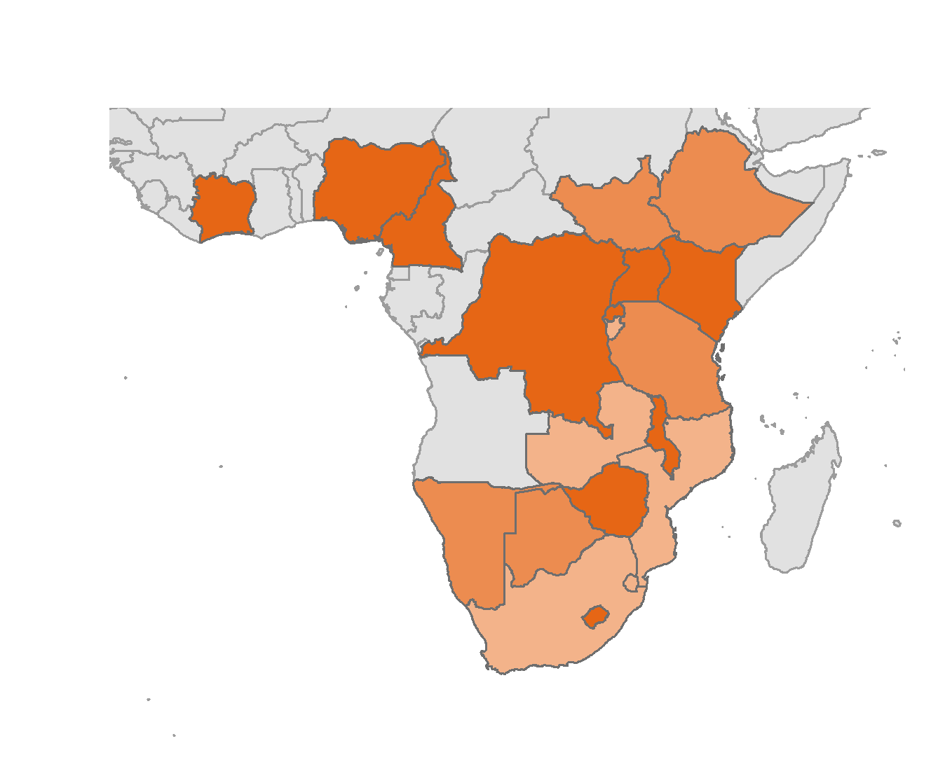
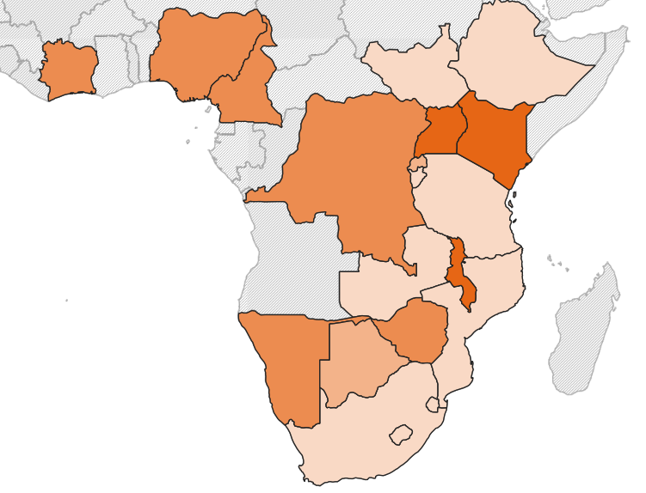
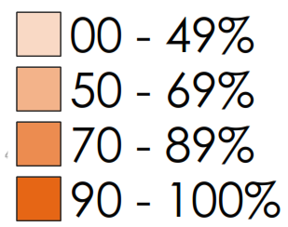
% of OVC with HIV status known or
test not required
85%
(FY19 Q2)
64%
(FY18 Q2)
Source: Cleaned USAID MER data

Slide 56
HIV status
Global results
Source: Cleaned USAID MER data

Slide 57
25% with unknown HIV status
What are the explanations?
OVC enrolled but HIV risk not yet assessed
OVC has been approached, but did not agree to answer the risk assessment questions
OVC has been assessed and is at risk for HIV, but has not yet accepted referral for HIV testing
OVC has accepted HIV testing referral but has not yet completed the test
OVC has completed the HIV test, although test result is not available
OVC has been approached by caseworker but has not yet agreed to share test result
No data available: missing!

Slide 58
Risk assessment continuum
Where are the children lost?
OVC not assessed
for HIV risk
Test not
required
Never
referred
Referral
pending
Status not reported

Slide 59
Noteworthy progress
HIV risk assessment continuum
83% of OVC with unknown HIV status were risk-assessed
42% of OVC at risk were referred for HIV testing
Source: Implementing partner internal monitoring data

Slide 60
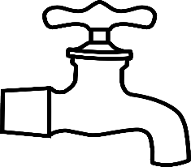
Noteworthy progress
HIV risk assessment continuum
Summary of results from the COP17 HIV risk assessments
Referral completion is 76%
Project maximizing electronic referral tracking: caregivers unwilling to get an HIV test for their children receiving disclosure counseling
Linkage rate is 100%
by leveraging test- and-treat rollout in the districts
Source: Implementing partner internal monitoring data
Notes:
41512 OVC were assessed OVC
4523 OVC were identified as at risk were referred for HIV testing services at local clinics
8 tested positive and were linked to care and treatment.
As a side note, 36 989 found not to be at risk were supported with HIV prevention interventions to ensure they remain safe and stay free from new infections.
Positive aspects
Nice use of “dripping faucet” image!
Great overlay of percentages on top of absolute numbers
Enjoy the commentary directly on the graphic
Ditto for linkage to ART
How can this graphic be improved?
Not clear how many OVC were HIV status unknown
Also, missing to know how many were HIV negative – we need BOTH numbers to improve performance
So possibly, consider tracking how many disclosed new HIV status
And of those, how many were HIV negative!

Slide 61
Noteworthy progress
Performance report for regions
Proportion of children with known versus unknown HIV status, by region
Source: Implementing partner internal monitoring data
Names of districts have been replaced with numbers 1−8
Notes:
This is so exciting!
I would ask that this group clarify their calculations for the unknown – I assume that this includes those for whom the test is not required?
This is excellent transparent communication.
The ideal is to share feedback and pair high performing with lower performing regions.
Would further ask if there is another way to splice these data?
Is the regional representative may be in a position to take action? And/or is this better directed to CBO’s?

Slide 62
Noteworthy progress
HIV care continuum
100% HIV-positive enrolled in program have been linked to ART
47% of those on ART have a documented viral load test
24% of those on ART are virally suppressed
?
Source: Implementing partner internal monitoring data
Notes:
Wonderful application of cascade visualization to the HIV care continuum.
When you view the outcome (# with viral load suppression), need to ask the question, where can we intervene?
It would seem that there is a process problem; low proportion of documented viral load test.

Slide 63
Perspectives
Leveraging RHIS data through simple and compelling visualizations has yielded programmatic innovations.
Enhanced use of data for decision making improves the linkage of vulnerable children to HIV testing services.
Performance improves when expectations are clear, and calculations standardized.
Regular, transparent feedback using RHIS data is a powerful mechanism for improving performance.

Slide 64
Measuring
what counts
Improving data quality contributes to epidemic control

Slide 65
Data quality assessment: A short history
The original data quality assessment (DQA) tool was developed in 2007 and piloted in 3 countries in 2008.
The World Health Organization (WHO) adopted the DQA and applied it globally between 2008 and 2011.
Over time, the DQA has been established as a standard in assessing data quality.
Adapted in an array of ways:
Routine data quality assessment (RDQA)
Gender-integrated routine data quality assessment (RDQA+G)
Data quality review (DQR): WHO adopted this and has implemented it in 20 countries so far
Lot quality assurance sampling (LQAS) DQA
Mini and expedited DQA
Notes:
Routine DQA, meant to be applied regularly to assess data flow and data accuracy, timeliness, and completeness. Meant to assess routine systems routinely to monitor data quality over time.
Data Quality Review is a national level review meant to look systematically at data quality across a range of health areas. Is a place to triangulate data sources and include desk review.
LQAS, Mini-, and Expedited DQA are rapid assessment methods with different goals. LQAS is a method of doing rapid checks at certain sites or in certain indicators as part of routine monitoring to check that data quality is on check. Mini dqa is a RDQA in a small area or small sample of sites. Often used as formative research to inform larger DQA efforts to come. Expedited DQA emphasis is on verification of patient information including lost to follow up.

Slide 66
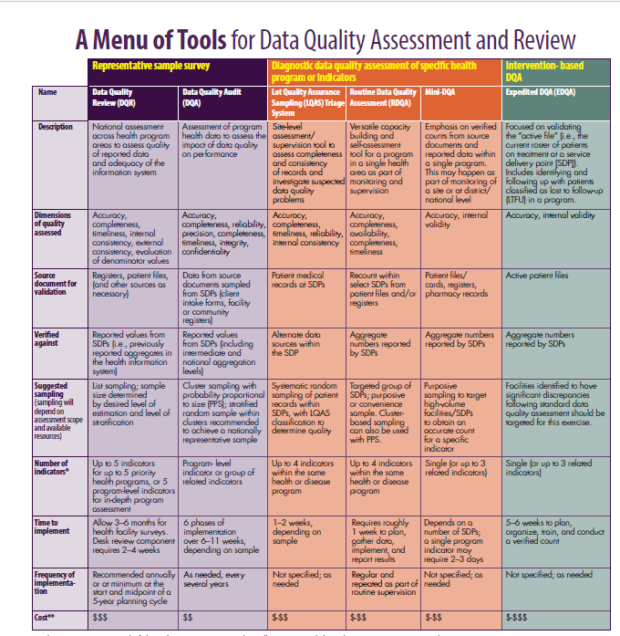
Menu of tools for DQAs
MEASURE Evaluation has developed a menu of tools for DQAs showing:
Type of assessment
Source documents required
How findings are verified
Suggested sampling
# of indicators
Duration of assessment
Cost
Notes:
This variety of adaptations of DQA just in Meval’s portfolios can be confusing. We dev

Slide 67
DQA in Zambia
Two indicators: HTS_POS and TX_NEW
Three-step process with cross-verification in 10 facilities in Kabwe District and 21 facilities in Kitwe District
Main findings:
Process for receiving, documenting, and counting community referral clients at the facility needs improving
Immediate initiation on antiretroviral therapy (ART) was not always available
Gold standard for conducting DQA—Ambassador Birx, PEPFAR
Notes:
Level 1/Step 1. Interviews at Headquarters Office of Z-CHPP, Open Doors, SAFE, and DISCOVER-Health \
Level 2/Step 2. Community Partner District Office
Level 3/Step 3. Selected Referral Facilities in Two Districts: 10 Facilities in Kabwe District and 21 Facilities in Kitwe District

Slide 68
How we have supported DQAs
Supported multiagency initiative in Uganda: 2 regions, 3 indicators, 78 facilities
Supported joint U.S. and Kenya government DQA in Kenya: 2 counties, 4 indicators, 13 facilities
Trained implementing partners and officials in Burundi to conduct a DQA with 3 indicators
In Haiti, developed the protocol and trained for a DQA to be conducted in 13 facilities with 3 indicators. Training used for full interagency DQA.
In South Sudan, facilitated DQA in 13 sites with 3 indicators

Slide 69
DQA “helpful hints”
This guidance coming soon
Includes tips for preparing to train and deploy field teams new to DQA
Highlights common obstacles faced when deploying multiple teams to the field simultaneously
Covers denominator concerns, encountering multiple data collection forms and tally sheets on the ground, and using technology to share questions and answers across teams when a team faces an unexpected challenge.

Slide 70
Sustaining the impact
Triangulation with additional data when routine and HMIS data are not enough

Slide 71
When available data aren’t enough
Implementation science and improving HIV programs
There are circumstances when additional data are called for:
To improve understanding of barriers to access for “missed” or hard-to-reach populations
To improve routine monitoring indicators
To monitor prevention behaviors
To answer specific programmatic questions

Slide 72
To understand barriers and opportunities for reaching “missed” populations
Male characterization studies
Haiti
Survey results from men show an increase in condom use and HIV testing when men talk about these issues with AGYW sexual partners.
Meetings with girls in the DREAMS (Determined, Resilient, Empowered, AIDS-free, Mentored, and Safe) program suggest that girls don’t think they can influence their male partners to get tested.
I think they have to decide for themselves; they are not children. The only thing I say to him is that I am HIV-negative and wish he is also negative.
If I influence him, it may be unconsciously when I told him about my HIV status.

Slide 73
Measurement of the PEPFAR indicator Gend_GBV
Gend_GBV reporting appeared inconsistent and hard to interpret across countries.
There was the need to improve the consistency of Gend_GBV reporting for improved interpretation within and across countries.
Based on indicator definition and better understanding of challenges, a data quality review tool was adapted, piloted, and launched. A recorded webinar discussing best practices for reporting this indicator is available at:
www.measureevaluation.org/resources/publications/fs-19-339a

Slide 74
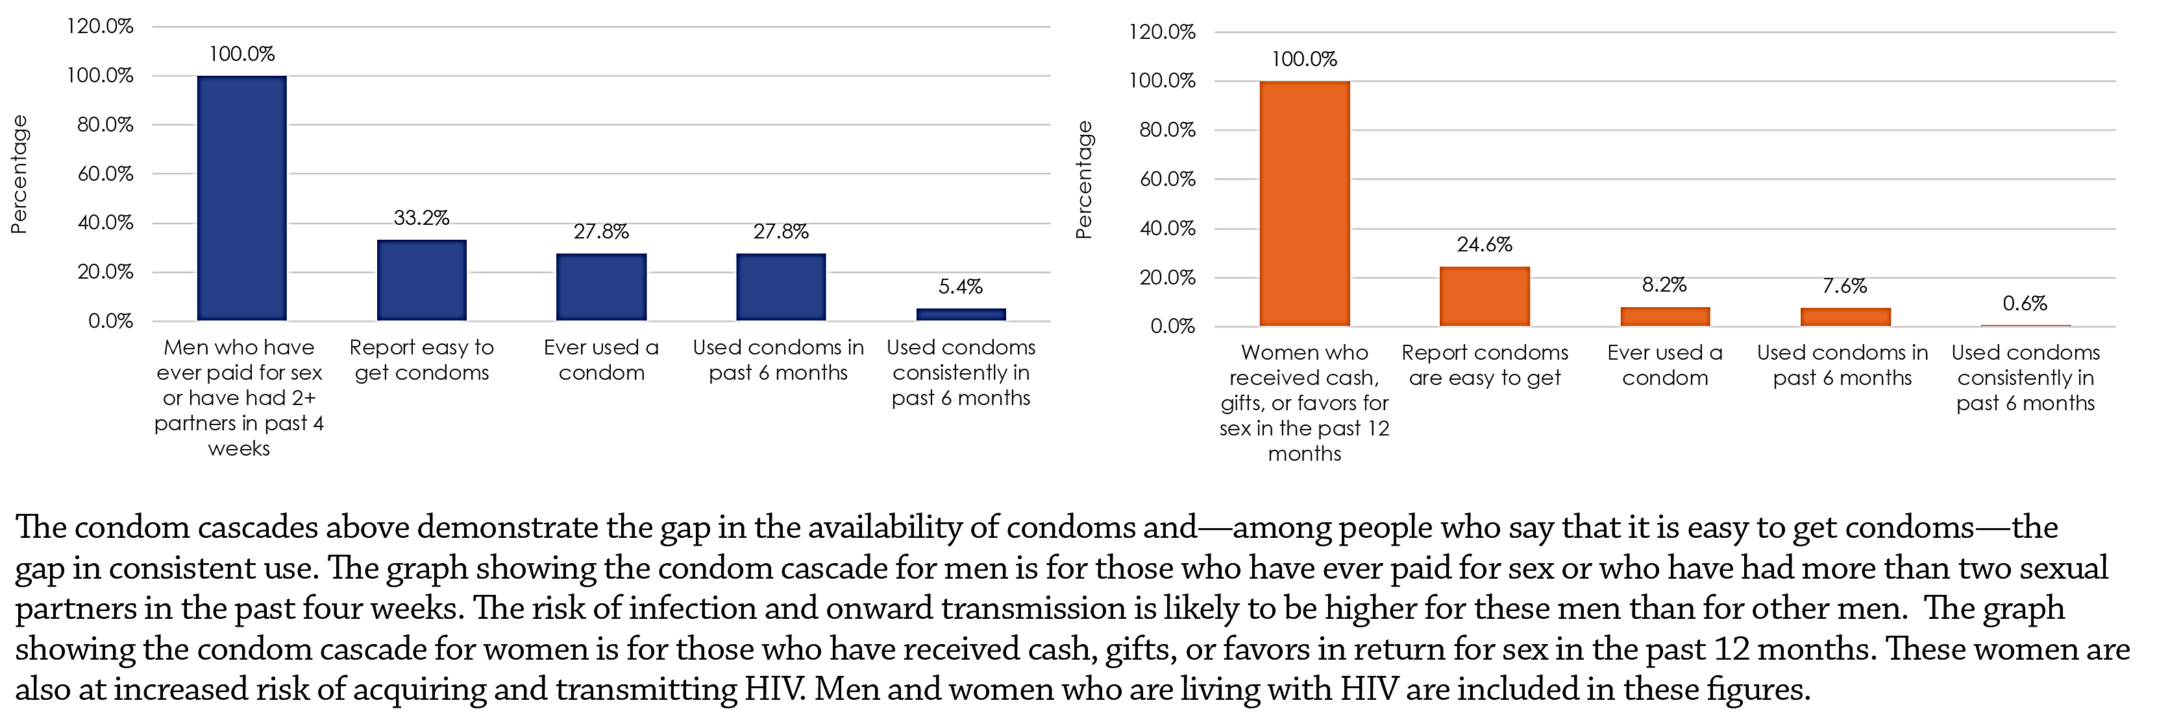
Condom cascade in Uganda
Prevention cascade:
Condom availability and use among men who paid for sex or who reported two or more partners in the past 4 weeks
Prevention cascade:
Condom availability and use among women who received cash, gifts, or favors for sex in the past 12 months

Slide 75
Asking additional programmatic questions
The example of the PHFS legacy evaluation

Slide 76
Background
Our situation
Notes:
In 2017, MEASURE Evaluation had to design an evaluation of a project that was implemented from 2012-2016.
Because this multi-country, multi-partner project ended in 2016, this was a retrospective evaluation situation, and MEASURE Evaluation started investigating legacy evaluations and ways to use existing routine data and to gather relevant primary data as well.

Slide 77
Partnership for HIV-Free Survival (PHFS)
GOAL: Designed to use basic quality improvement (QI) practices to reduce mother-to-child transmission of HIV and increase child survival through improvements in:
ART uptake and retention among HIV-positive pregnant women and mothers
Breastfeeding practices
Overall mother-baby care
Funded by PEPFAR through USAID, from 2012–2016
Notes:
The project was asked to evaluate the outcomes of the PHFS, which had the following goal.

Slide 78
PHFS countries
Six countries
Notes:
Six countries in sub-Saharan Africa:
3 in East Africa: Kenya, Tanzania, Uganda,
3 in Southern Africa: Lesotho, Mozambique, South Africa

Slide 79
Background
Our situation
Notes:
Given the retrospective nature of the exercise, the team decided to look at the outcomes through multiple lenses.
However, there is not a lot in the literature about legacy evaluation, so this was a new and challenging situation. The body of evidence is still evolving, and we hope this example will be an important contribution.

Slide 80
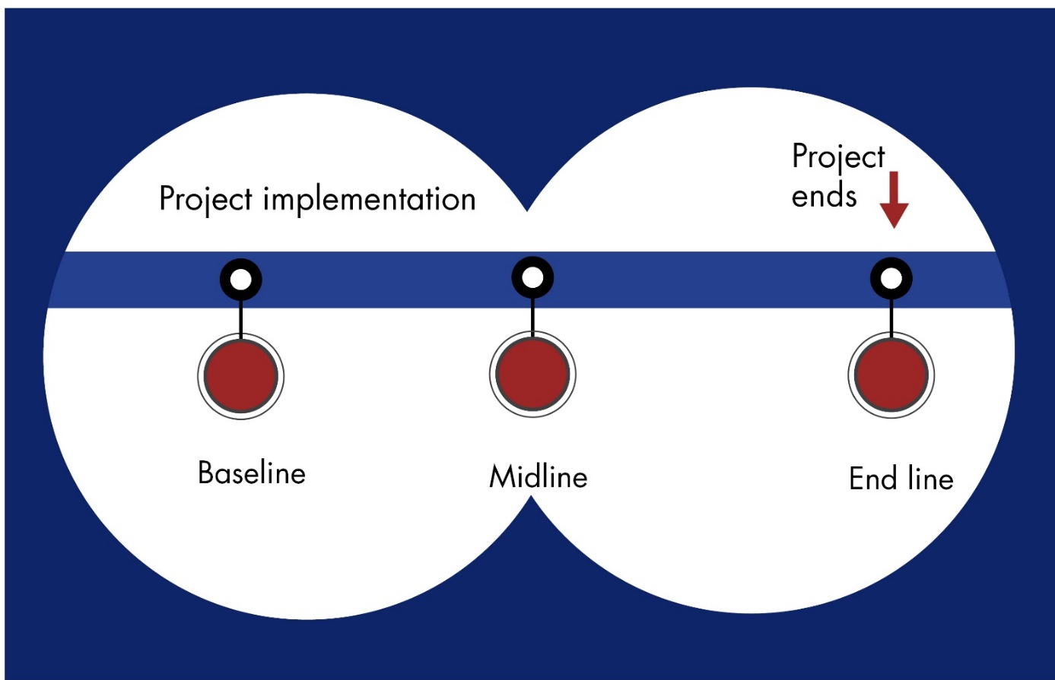
Legacy evaluation
Legacy
Notes:
This graphic illustrates your typical project and evaluation timeline. In this case, the evaluation was initiated not only after primary implementation and scale-up, but in fact after all activities were completed. Some elements of the evaluation have only recently been completed even two years after project close.
The evaluation used a mixed-methods approach, relying heavily on an extensive document review, site visits, and qualitative interviews with a wide range of project stakeholders including stakeholders at national, regional, district, facility, and community levels, including government, NGO, academic, and community organization respondents in all six PHFS countries as well as with headquarters staff. The evaluation team also visited dozens of implementing sites across the PHFS countries.
The team developed an inclusive interview guide covering multiple issues related to the implementation and success of PHFS, including perceptions of QI, partnership structure, activity design, implementation, outcomes, successes, and challenges. The guides were designed to be adapted for different audiences relevant to the evaluation, including Ministry of Health representatives, subnational-level health representatives, local USAID mission, PEPFAR implementing partners, on-site health facility staff, community health workers, and patients.
During visits to implementation sites, the evaluation team would—whenever possible—scan QI journals and other day-to-day documentation (e.g., registers) to better understand the dynamics of the PHFS approach as well as its continuing use and effectiveness. At the end of each country visit, the evaluation team would synthesize the findings and, as the number of visited countries grew, compare the findings with those in other countries to identify and understand similarities and differences.

Slide 81
Two evaluations of PHFS
Conducted by the USAID- and PEPFAR-funded MEASURE Evaluation project
Outcome evaluation of PHFS in Uganda
Institutional review board (IRB) approval from the University of North Carolina at Chapel Hill (UNC) and Makerere School of Public Health
Approval from the National Council for Science and Technology
Conducted from June 2018–January 2019
Six-country legacy evaluation of PHFS
IRB approval at UNC
Conducted from June 2017–February 2018

Slide 82
MEASURE Evaluation
Outcome evaluation of PHFS in Uganda
Aim 1: Determine whether and to what degree the PHFS approach achieved its intended outcomes in terms of prevention of mother-to-child transmission of HIV (PMTCT) implementation and maternal and child health outcomes at the patient level during the period of implementation and after implementation ended
Retrospective quantitative chart reviews of existing patient-level routine program data
Aim 2: Gather information on the implementation of PHFS in Uganda with a focus on the QI component and the legacy of PHFS
Primary data collection through in-depth interviews and focus group discussions

Slide 83
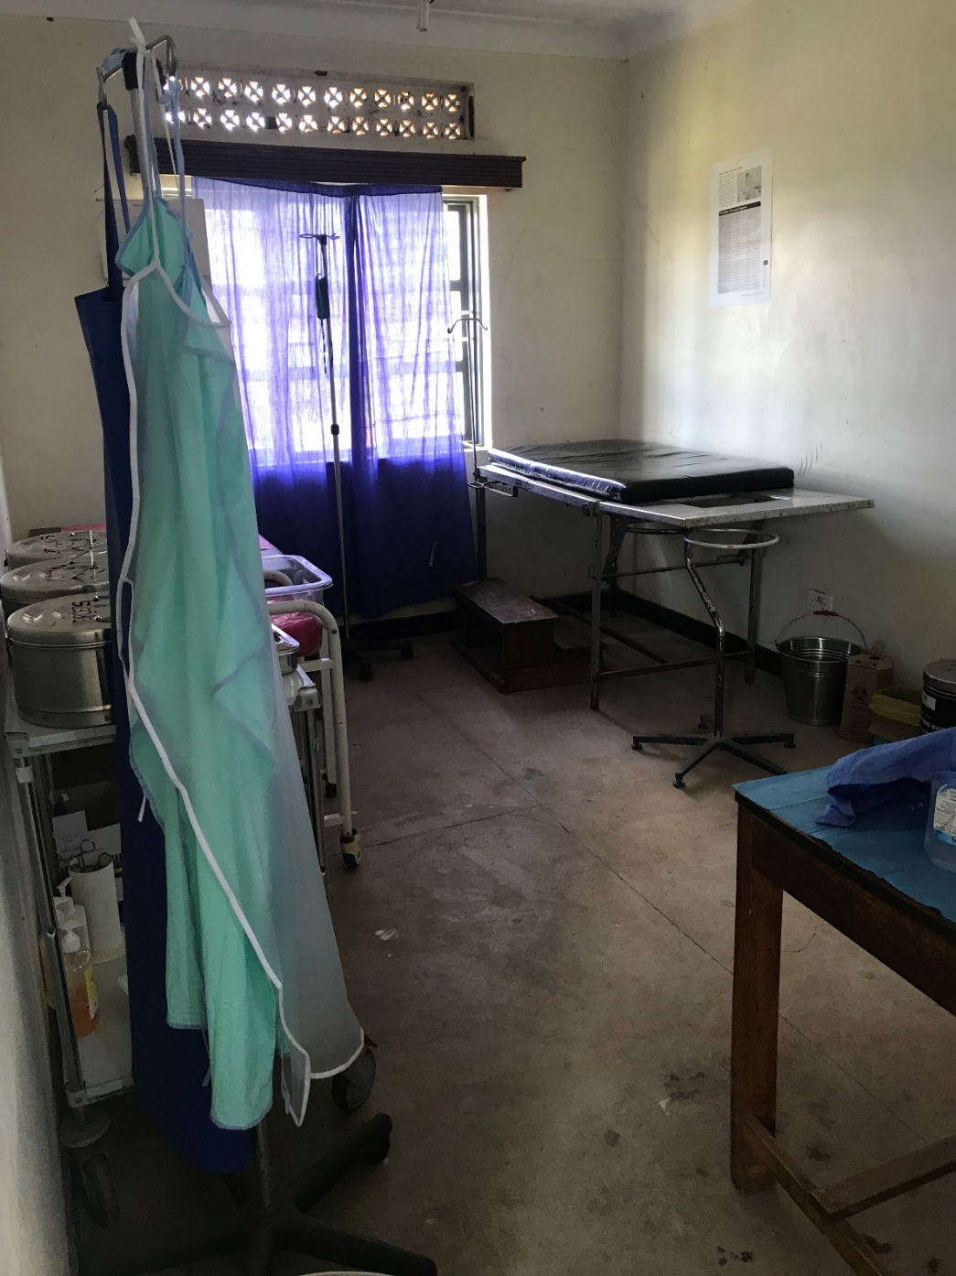
Outcome evaluation of PHFS in Uganda
Quantitative component
Measure impact of PHFS in demonstration and scale-up sites
Measure sustainability of PHFS in demonstration and scale-up sites after the program ended

Slide 84
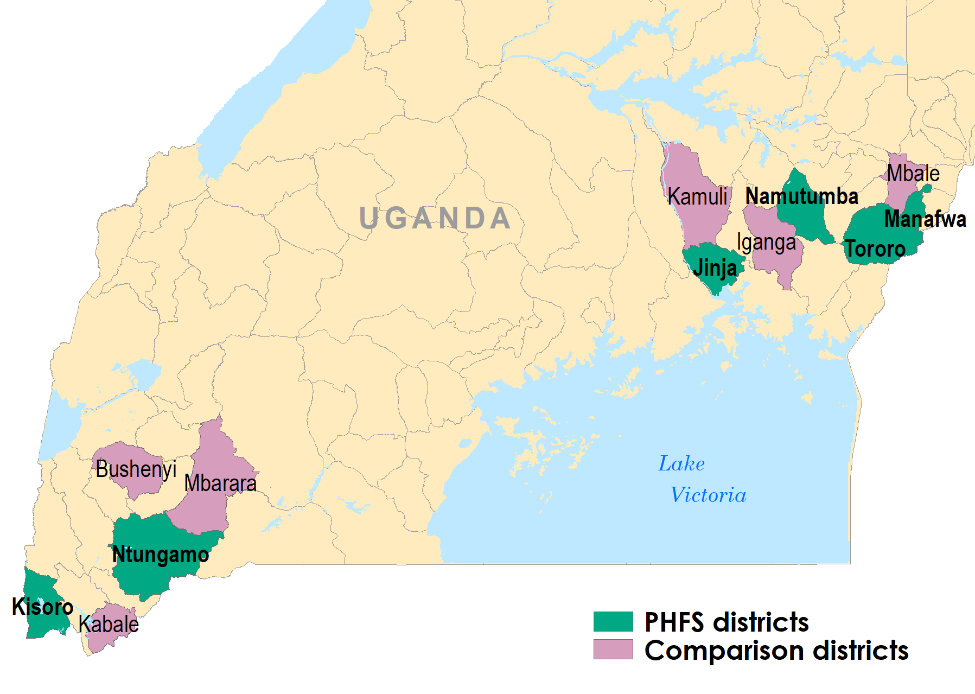
Study districts and sites
Notes:
We selected a total of 19 demonstration facilities, 18 scale-up facilities, and 24 comparison facilities for inclusion in the study. Out of 22 demonstration facilities, we excluded four with the lowest patient volume based on information from the implementers. We randomly selected scale-up facilities from 59 that participated in the program. We randomly selected comparison facilities from 145 PEPFAR-supported facilities in the six comparison districts

Slide 85
Retrospective longitudinal design
BEFORE
DURING
AFTER
February 2011:
Data extraction start
April 2013:
Start PHFS demonstration sites
October 2014, December 2014, February 2015:
Start PHFS scale-up sites
August 2016:
End PHFS all sites
December 2018:
Data extraction end
Comparison sites (n=24)
Demonstration sites (n=18)
Scale-up sites
(n=18)
September 2012:
Option B+ adopted
October 2014: Uganda changed national policy to include integration of services in mother-baby care points
Notes:
This evaluation used a retrospective longitudinal design to assess the success of the PHFS program by comparing patient outcomes across the demonstration, scale-up, and comparison sites. Patient-level data collection was retrospective, starting from February 2011, prior to the PHFS implementation, and continuing to December 2018. Data from before the implementation of PHFS serves as a baseline and data after the close of the PHFS is used to measure sustainability.

Slide 86
Data extraction
Data extraction using digital tablets at all three types of facilities:
Patient-level data from mother and baby cards
Starting from birth or when mother-baby pairs enrolled
Continuing until the pair was lost to follow-up, child died, or child became 18–24 months old
Facility-based survey on:
Staff
QI teams and procedures
Notes:
Data collectors extracted patient-level data on mother-baby pairs from health facility records. Individual-level data was obtained for each month starting from birth or from the time the mother-baby pair was enrolled until the pair was lost to follow-up, the child died, or the child became 18 months. As the data collectors entered patient-level data, they documented if data were missing by selecting a “missing” code. Facility-level data were also collected, including information on staffing and PMTCT services. Data collectors obtained the same data from facilities and patient records across PHFS demonstration sites, PHFS scale-up sites, and comparison sites.

Slide 87
Difference-in-difference analysis
IMPACT
Before vs. during PHFS
SUSTAINABILITY
During vs. after PHFS
Demonstration vs. Comparison
Scale-up vs. Comparison
Exclusive breastfeeding
12-month retention in care
18-month mother-to-child HIV transmission
18-month HIV-test data completeness
Notes:
Evolving impact and sustainability in 6 month time blocks.

Slide 88
Data challenges:
Uncertainties about available data on individuals
Do not know number of unique mother-baby pairs
Do not know how much observational data are contained in the records over time―data quality and completeness issues vary over time and with the existence of PHFS
Different processes and timelines for scale-up of PHFS, particularly because in Uganda the national policy was changed to include integration of mother-baby pairs in mother-baby care points

Slide 89
MEASURE Evaluation
Six-country legacy evaluation of PHFS
Goal: To assess the outcomes at the national and district levels of PHFS on PMTCT programs in the six countries, and to capture key learnings from PHFS implementation that contribute to the scale-up of activities
Methods: Rapid assessment in all six PHFS countries—interviews with all partners and stakeholders at the national and district levels
Notes:
The critical consideration when planning the evaluation was the fact that PHFS had ended more than a year before the evaluation formally began. Consequently, the assessment was done as a legacy evaluation to provide a holistic picture of what had been done across the six participating countries and to explore the effects that outlived the implementation period. The challenges of organizing a legacy evaluation (e.g., key staff, who had moved on to other assignments, had to be tracked down; institutional memory had declined; records and data were less accessible) increased the amount of time between the end of the project and the completion of the evaluation. However, the passage of time helped spotlight or clarify key components of the PHFS legacy.
Given that the PHFS program implementation was finished in all countries prior to MEASURE Evaluation’s engagement with the evaluation activity, it was essential to speak with people that had participated in the implementation to understand the outcomes at the facility and district level. Routine health information did not address the nuances of how teams organized around QI tracking and change ideas. The RHIS doesn’t include answers to why improvements were observed.

Slide 90
PHFS evaluations
Overlap in data collection
Extensive document review, site visits, and qualitative interviews with a wide range of project stakeholders in 6 PHFS countries
6-country legacy evaluation
Qualitative component of the outcome evaluation in Uganda
In-depth interviews with healthcare workers and district-level QI coaches
Focus group discussions with QI teams at model health facilities

Slide 91
PHFS retrospective theory of change
Notes:
A retrospective theory of change shows what was done to achieve results as opposed to the more common use of a theory of change to show what is planned. The retrospective theory of change also incorporates findings from all six countries, demonstrating the commonalities across them. In this presentation we will show you this now, at the beginning, but in the report you will see that this is at the end since we built it through our evaluation.
Our retrospective theory of change for PHFS shows how different core activities played out in the PHFS countries. It also identifies specific links between individual activities.
Although the retrospective theory of change encapsulates the experience from the six PHFS countries, it is important to note the inherent flexibility in how the activities are grouped, linked, and implemented, particularly the degree and/or emphasis of the activity. Essentially, all six countries used the same overarching approach, but they made appropriate adaptations for their local context. For example, in different countries—and even in different settings within the same country, the extent and nature of the QI components varied, but their role was always essential. Similarly, there were variations in how PHFS facilities implemented mother-baby pairs, mother-baby clinics, and the integration of services, but the principles behind these activities remained the same.
Note that the left side of the theory of change shows the core activities that must be in place for the PHFS approach to work. (Read the pink box)

Slide 92
Recommendations/legacy
Ending maternal-to-child transmission of HIV (eMTCT)
Although the footprint of PHFS was small, the lessons and the potential are large.
If more countries enabled facility staff with the requisite knowledge and skills to pursue the approach, the goal of eMTCT of HIV would be more reachable than ever.
Notes:
Although the footprint of PHFS was small, the lessons and the potential are large. If more countries enabled facilities with the requisite knowledge and skills to pursue the approach, the goal of eliminating mother-to-child transmission of HIV would be more reachable than ever. And if an investment were made in further refining the PHFS approach (e.g., nutrition services, mentoring/coaching, knowledge sharing and transferability to other health services, including ART clinics), there would be commensurate gains in the delivery of health services and the health and well-being of patients.
The lessons of PHFS should be more widely known and more widely emulated.

Slide 93
Value of additional data
Additional data allowed us to assess which operational and QI changes within facilities made a difference in PMTCT and nutrition service delivery, linkages, and retention.
The routine health information system (RHIS) does not record or track shifts in approach that can lead to significant improvements in key indicators.
Notes:
Evolving impact and sustainability in 6 month time blocks.

Slide 94
Value of additional data
Allowed us to assess which operational and QI changes within facilities made a difference in PMTCT and nutrition service delivery, linkages, and retention.
RHIS does not record or track shifts in approach that can lead to significant improvements in key indicators
Qualitative findings were corroborated with quantitative results on impact and sustainability indicators.
These findings have led to the development of a document outlining key recommendations from an implementation perspective aimed at improving eMTCT outcomes.

Slide 95
PHFS legacy evaluation report
www.measureevaluation.org/resources/publications/tr-18-314/
Notes:
Here is a link to the final report on the MEASURE Evaluation website. (show the report)

Slide 96
Other related documents
Thinking Strategically About Nutrition:
Key Issues in the Context of HIV and Tuberculosis
www.measureevaluation.org/resources/publications/tr-19-335
Coming soon: “How to” document based on learning from the PHFS evaluations
Offers global practical guidance on how to implement the components of PHFS that were successful

Slide 97
Sustaining
the impact
Taking stock and looking ahead

Slide 98
Accomplishments and priorities
On the sticky notes provided, please write:
The most important advancement in HIS for epidemic control over the past 10 years.
The most important priority for next steps in terms of health information and HIS for achieving epidemic control.
Notes:
This toolkit was also developed in collaboration with HDC. Many countries have completed assessments and more in progress in east Africa. The assessment has informed digital profile of country. Uganda drafted its privacy guidelines based on the findings of the assessment. Also, published a comparative document describing HIS Stages, HIS Interoperability, Digital Health Investment Review Tool, Global Digital Health Index, Digital Health Atlas and the Global Goods Maturity Model.

